Slide 1
H72
2018
6th November 2017 (21:00 GMT)
B4C1 (EUR)
B4C2 (U49)
B4C3 (CAL)
B4C4 (CAN)
B4C5 (AUS)
B4C7 (THA)
B4C8 (TWN)
B8M1(EUR)
B1M1(AUS)

Slide 2
* Local release dates are set based on each local marketing strategy.
* Any information for each model code can’t be disclosed by above mentioned local release date.

Slide 3
4
5
8
18

Slide 4
“Acquiring The newer MT-ness”
New exterior styling: more attractive look and greater pride of ownership
・All-new body panels and plastics
・New head light and styling to more closely resemble bigger MT models
・Detail changes throughout
EUR,U49,CAL,CAN, AUS
B4C1/8/B1M1/B8M1
…DPBMC/MNM3/MDNM6
B4C2/3/4/7
…DPBMC/MNM3/BWP1
B4C5
…MDNM6
DPBMC:DEEP PURPOSE BLUE METALLIC C
MNM3:MAT GRAY METALLIC 3
MDNM6:MAT DARK GRAY METALLIC 6
BWP1:BLUISH WHITE PEARL 1
・Same as current EG character
Revised chassis and seat: better performance in more sporty riding
・New front fork specs
・New rear shock with rebound adjuster
・More comfortable seat design
・Same as current digital instrument cluster and easy-to-operate switches

Slide 5
Model : H72
CONFIDENTIAL
FEATURE MAP : BODY
Running weight: 183kg (Compared to 1WS: 182kg)
Weight ratio: Front 49.2%(90kg), Rear 50.8%(93kg)
Newly designed scoop air and exterior covers
Handlebar with new color paint
(silver ➔ black paint)
Newly designed seat
Newly designed winglet and exterior covers
Newly designed headlight and winglets
Newly designed taillight
Front suspension settings is changed
Newly designed front fender
Front flasher location is changed
Newly designed radiator cover
Newly designed rear shock absorber
Brake pedal shape is changed

Slide 6
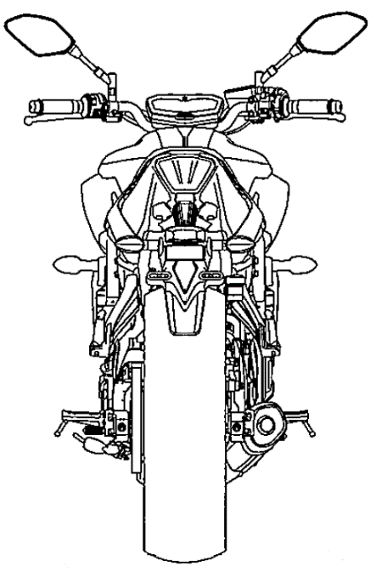
Model : H72
CONFIDENTIAL
DIMENSION MAP
ITEM |  | H72 | 1WS
A | Overall length | 2085 mm | ←
B | Overall width | 745 mm | ←
C | Overall height | 1090 mm | ←
D | Seat height | 805mm | ←
E | Wheel base | 1400 mm | ←
F | Minimum ground clearance | 140 mm | ←
G | Caster angle | 24.5 degrees | ←
H | Trail | 90 mm | ←
B
G
C
D
F
H
E
A

Slide 7
Riding position is same as 1WS
X: 660mm
Y: 860mm
Z: 485mm
Grip point
X
Hip point
Y
Z
Foot point

Slide 8
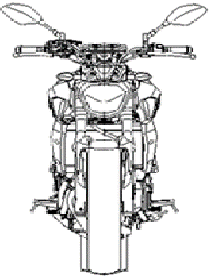
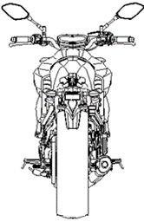
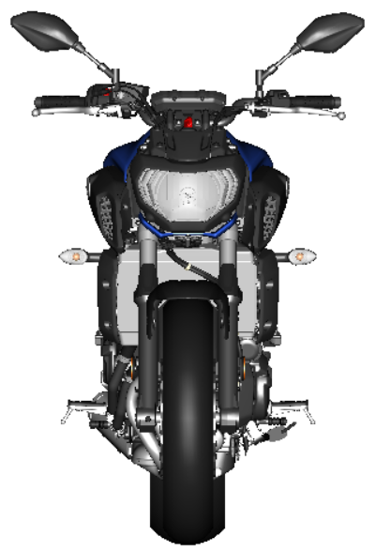
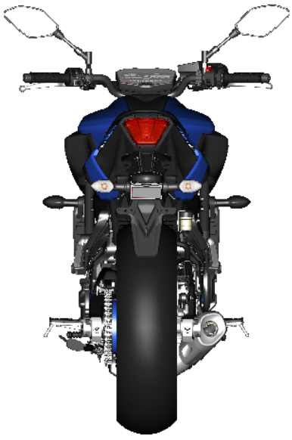
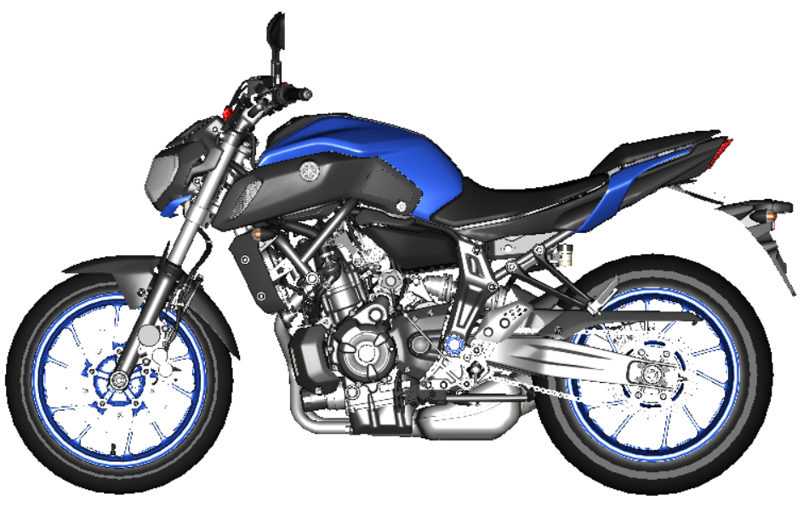
Exterior parts
New exterior design
Newly designed exterior covers
Color of handlebars, gearshift rods, brackets and more changed from silver to black
The number of covers and panels were reduced to refresh the model’s look
Attractive appearance
1WS
H72
・The exterior body panel and covers were all redesigned for higher quality

Slide 9
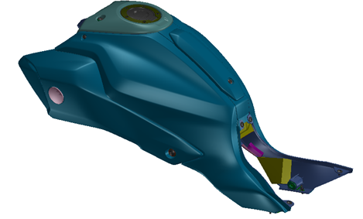
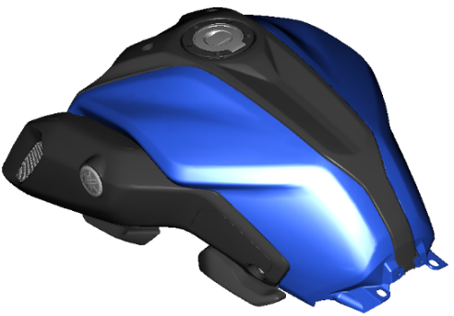
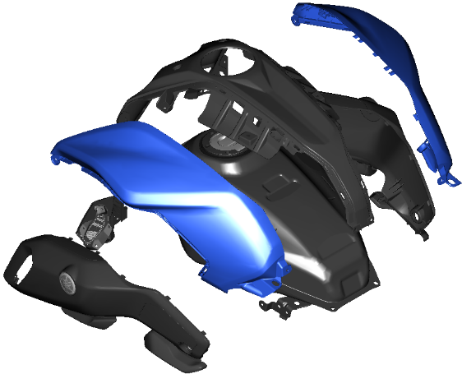
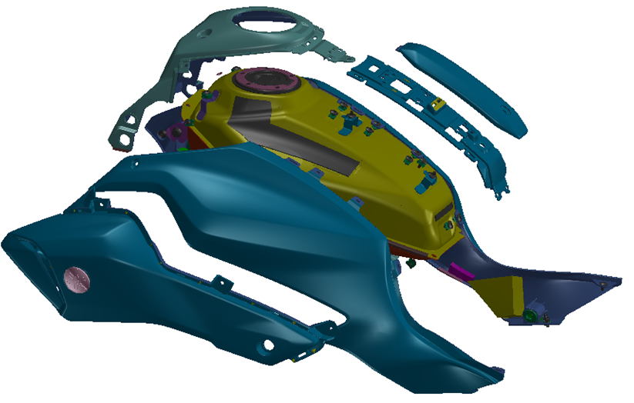
Fuel tank covers
New exterior design
Newly designed exterior covers , body panel and newly designed scoop air are adopted
Attractive appearance
Inner panel
Side cover
Scoop air
Fuel tank
1WS
H72
・The exterior covers were all redesigned for higher quality

Slide 10
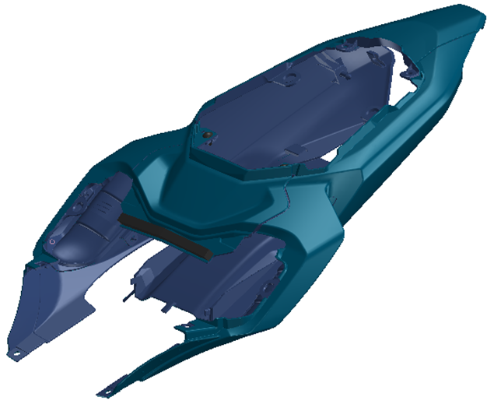
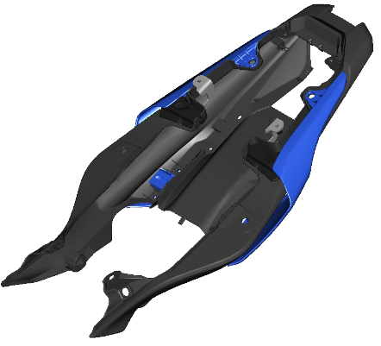
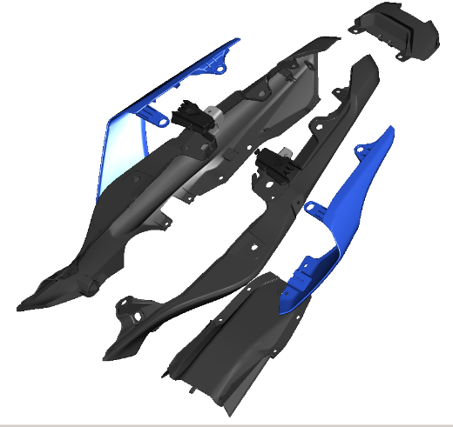
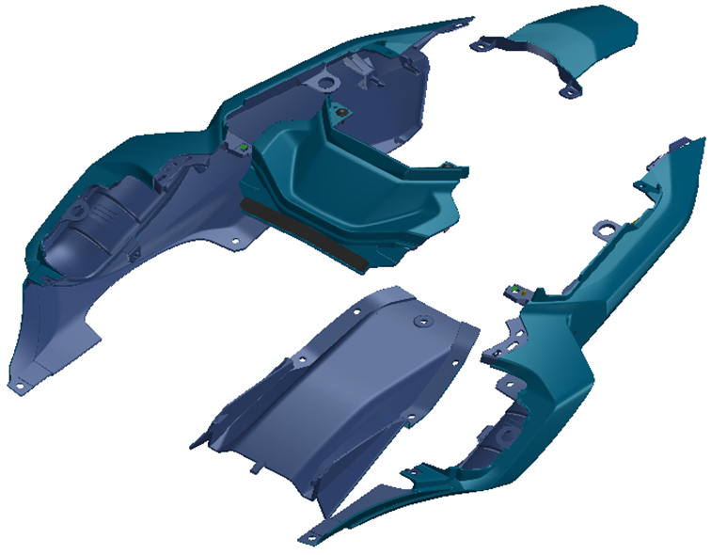
Rear cowl
New exterior design
Newly designed exterior covers and winglet are adopted
Attractive appearance
Taillight cover
Winglet
Rear fender cover
1WS
Side cover
H72
・The exterior covers were all redesigned for higher quality

Slide 11
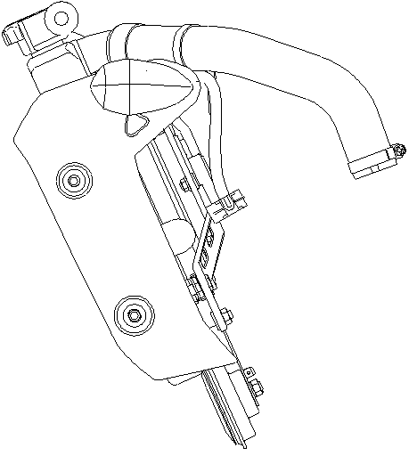
Radiator cover
New exterior design
Newly designed radiator cover is adopted
Front flasher location is changed from headlight cover to radiator cover
Attractive appearance
Front Flasher
Radiator
Radiator cover
・The exterior covers were all redesigned for higher quality

Slide 12
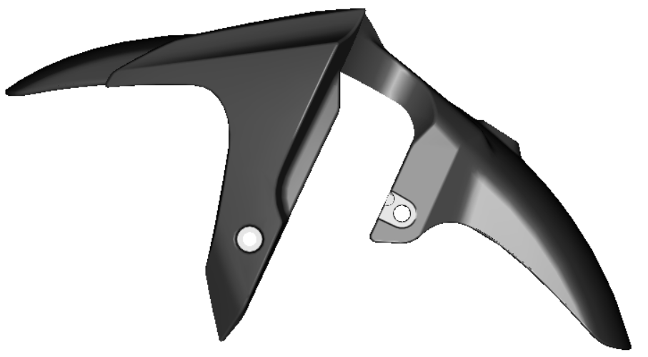
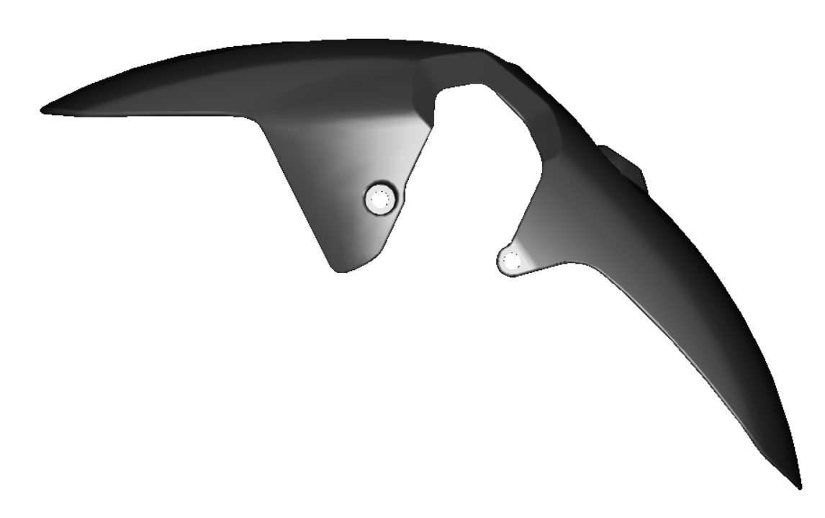
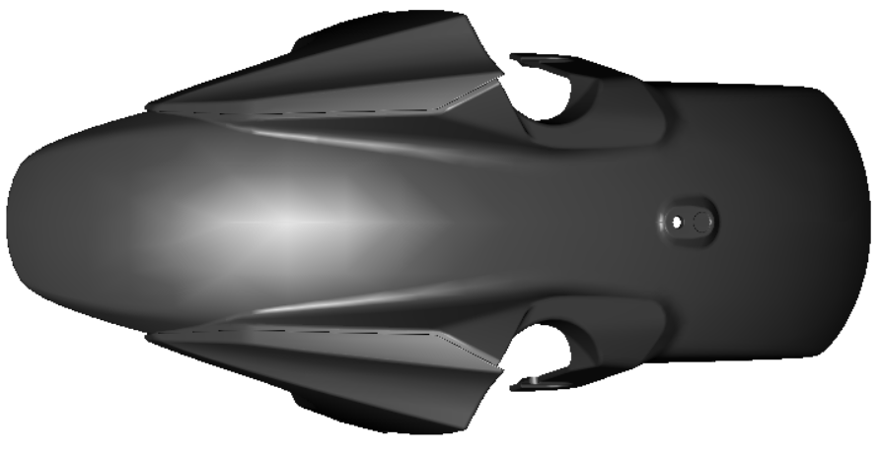
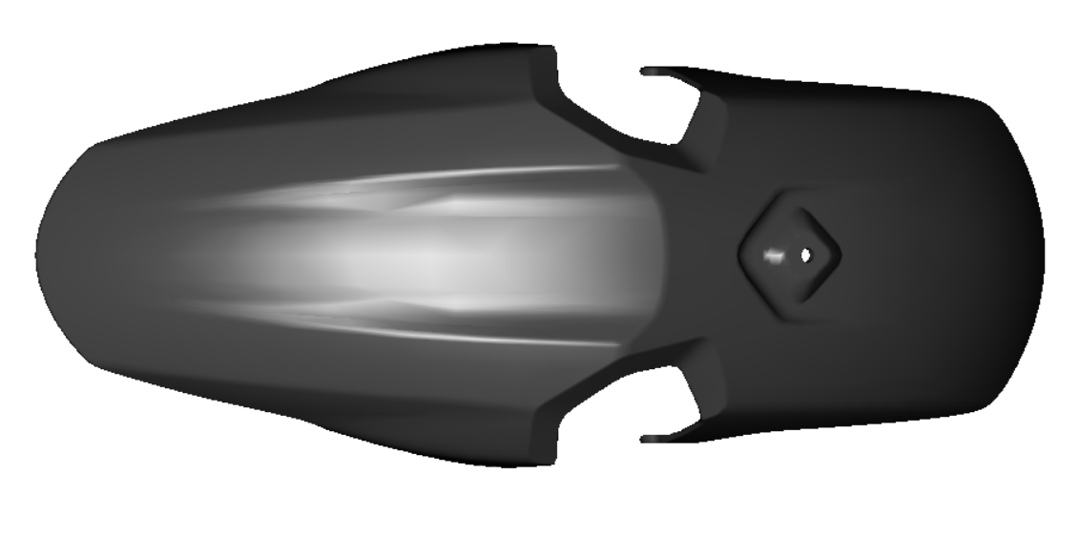
Newly designed front fender
New exterior design
Newly designed front fender is adopted
Consist of front fender is changed from 3-pieces to 1-piece
Attractive appearance
Side view
Side view
1-piece
Top view
3-pieces
Top view
1WS
H72
・The exterior covers were all redesigned for higher quality

Slide 13
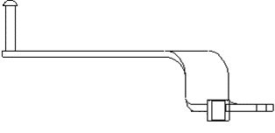
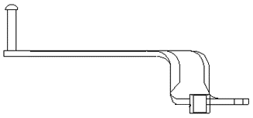
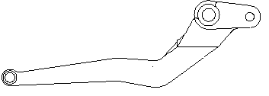
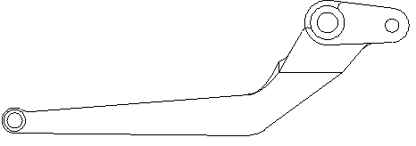
Brake pedal
Shape change
Shape is changed
New color paint (silver ➔ black paint)
Attractive appearance
194 mm
194 mm
40 mm
40 mm
62 mm
62 mm
222 mm
222 mm
1WS
H72

Slide 14
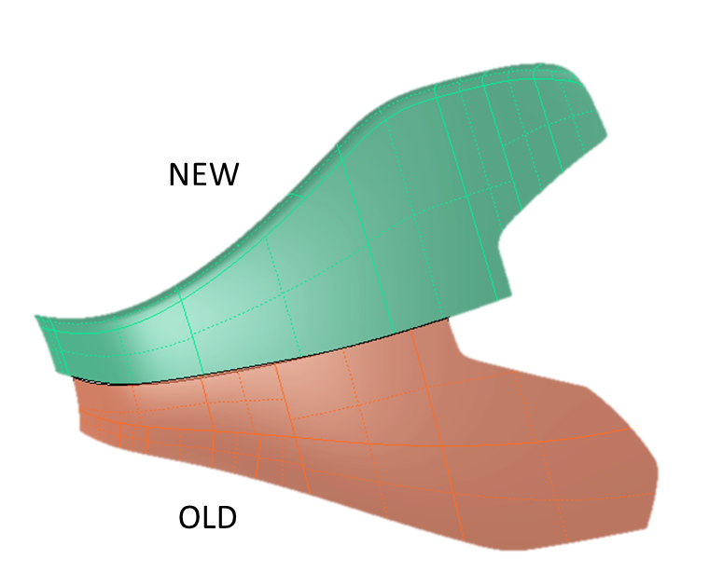
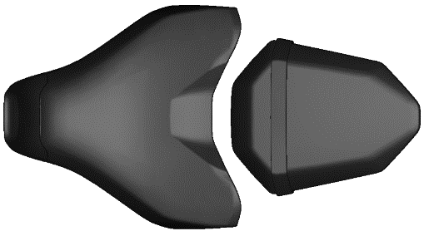
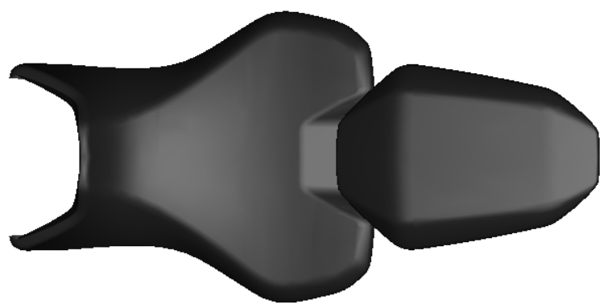
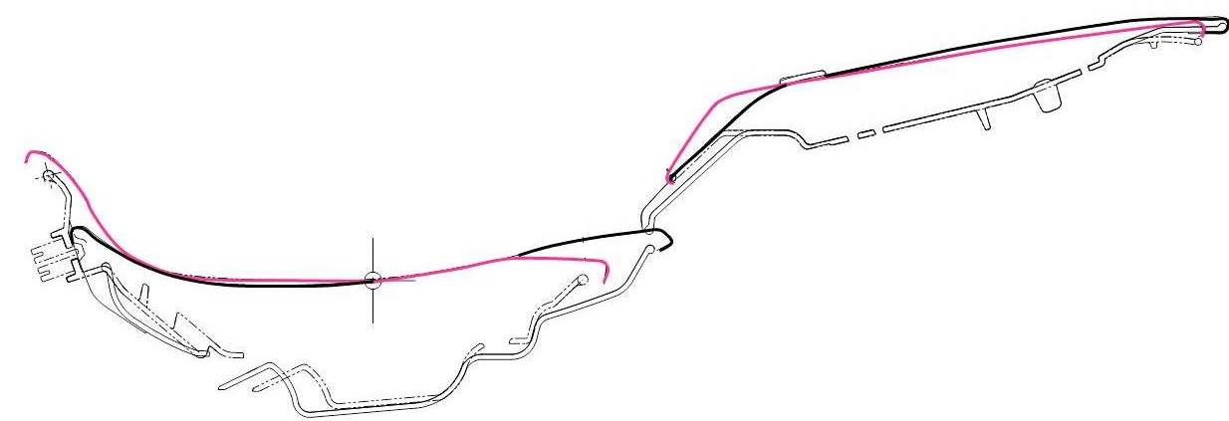
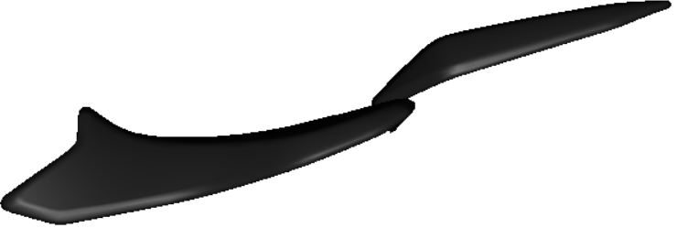
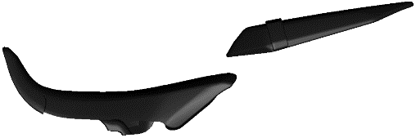
Seats
Optimize for wide range of riding scenes
Newly designed seat is adopted
Cushion volume is increased
Flat sitting portion for rider is increased by 30%
Leather spec is not changed
Optimized cushioning shape
H72
1WS
Top view
1WS
H72
- H72
- 1WS
Side view
・The front end of the seat was extended 10 mm forward onto the fuel tank area to bring more freedom to the riding position

Slide 15
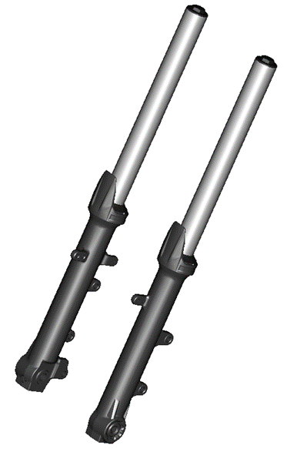
Front fork
Optimize for wide range of riding scenes
Spring and damper specification are changed
Shape is same as 1WS
Manufacturer is same as 1WS: KYB
Good handling
Items | H72 | 1WS
Stroke | 130 mm | ⬅
Spring rate | 18 N/mm | 17 N/mm
Tension damping force @ 0.3m/s | 180 N | 155 N
Compression damping force @ 1.0m/s | 130 N | ⬅
Oil quantity | 405 cm³ | 403 cm³
Oil level | 160 cm³ | 162 cm³
・Give riders a greater degree of adjustability and to better accommodate a wide variety of uses and rider skill levels

Slide 16
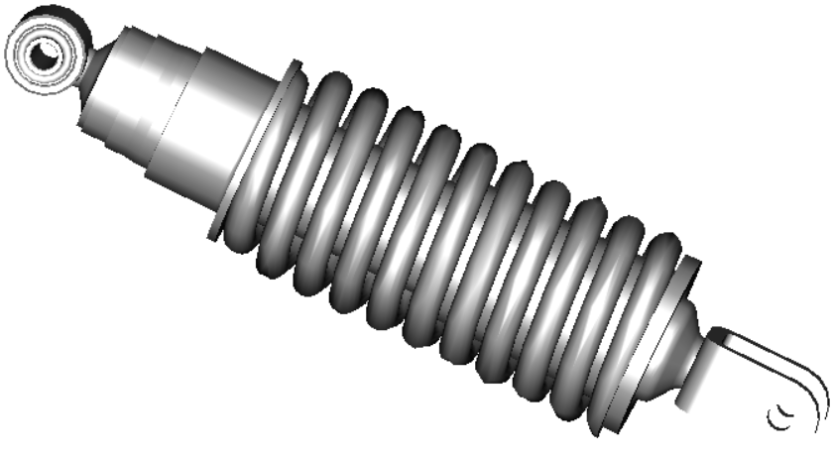
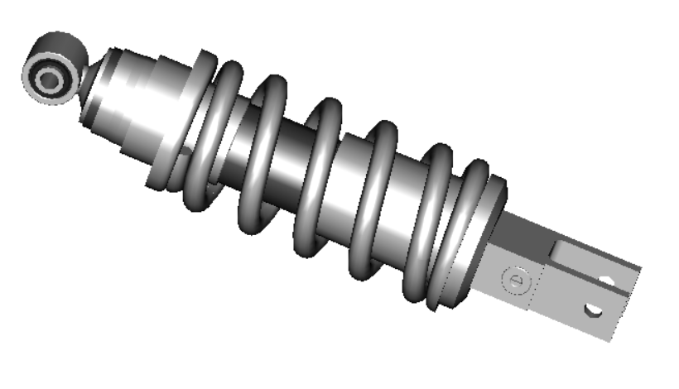
Rear shock absorber
Fun riding for wide range of riding scenes
Newly designed rear shock absorber is adopted
Spring and damper specification are changed
Rebound damping adjuster is adopted
Manufacturer is same as 1WS: KYB
Good handling
Items | H72 | 1WS
Spring rate | 120 N/mm | 107.8 N/mm
Tension damping force @ 0.3 m/s | 2200 N | 1730 N
Tension damping force @ 0.1 m/s | 765 N | 825 N
Compression damping force @ 0.3 m/s | 670 N | 480 N
Compression damping force @ 0.1 m/s | 350 N | 255 N
Rebound damping setting | Initial : One turn and half back from fully tightened position | -
Initial preload setting | 9 steps Initial: 3rd step | ⬅
1WS
Spring preload adjuster
H72
Rebound damping adjuster
・The rear shock gains the same rebound adjustability as the current MT-09 and easier preload adjustability.

Slide 17
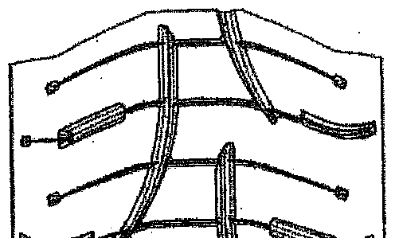
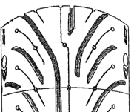
Tires
For good handling
Sport type tire is adopted. Manufacture: Michelin, Bridgestone
Michelin-spec version uses Pilot Road 4s
Bridgestone tire spec is unchanged
Good handling
FRONT | PILOT ROAD 3 TL 120/70ZR17 M/C(58W)
FRONT | PILOT ROAD 4 TL 120/70ZR17 M/C(58W)
REAR | PILOT ROAD 3A TL 180/55ZR17 M/C(73W)
REAR | PILOT ROAD 4 TL 180/55ZR17 M/C(73W)
1WS
H72
Tire air pressure
Front: 225 kpa / Rear: 250 kpa

Slide 18
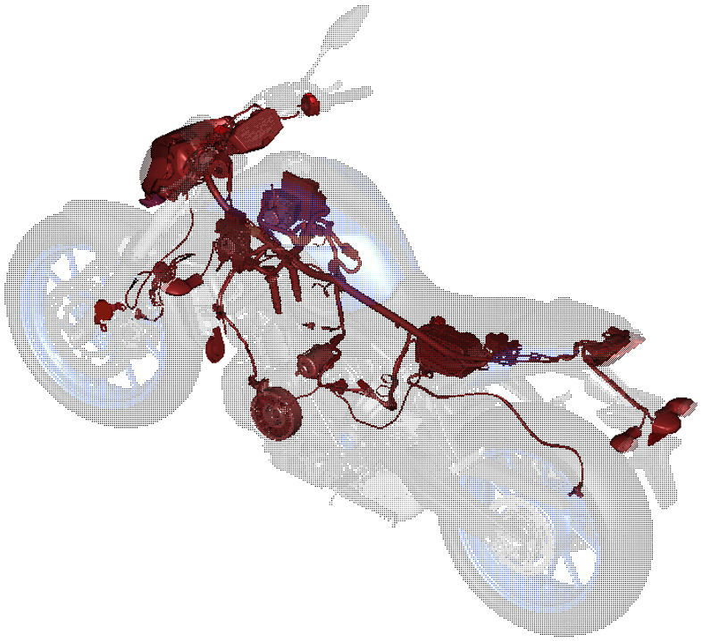
Electrical parts location
Optimized compact location
BU2 base wire harness is adopted
Wire harness specification is changed to correspond to change of front flasher location
To correspond to change of front flasher location
Main switch
Instrument panel
ECU
HU
Ignition coil
Rectifier regulator
Battery
Front wheel sensor
Rear flasher
Front flasher
Stator
Starting motor
Rear wheel sensor

Slide 19
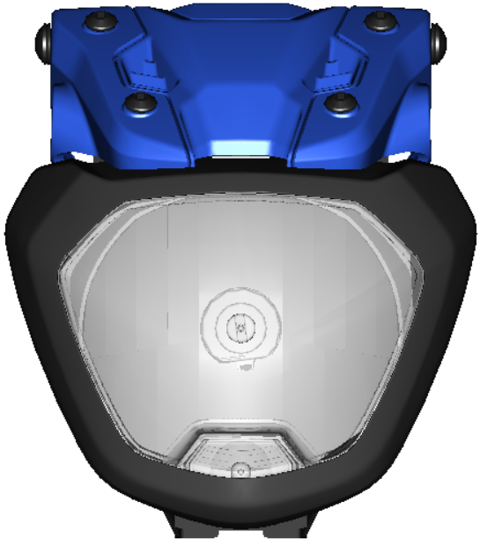
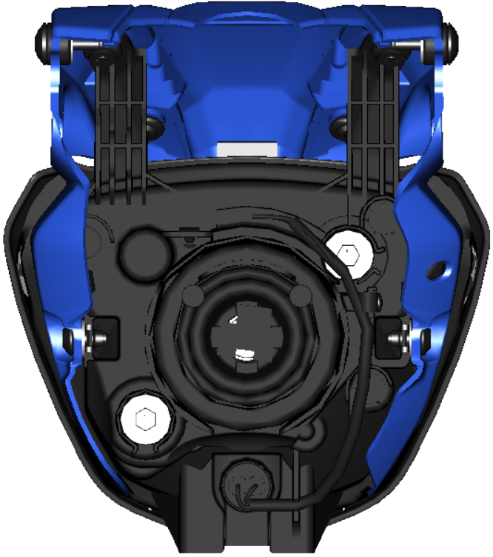
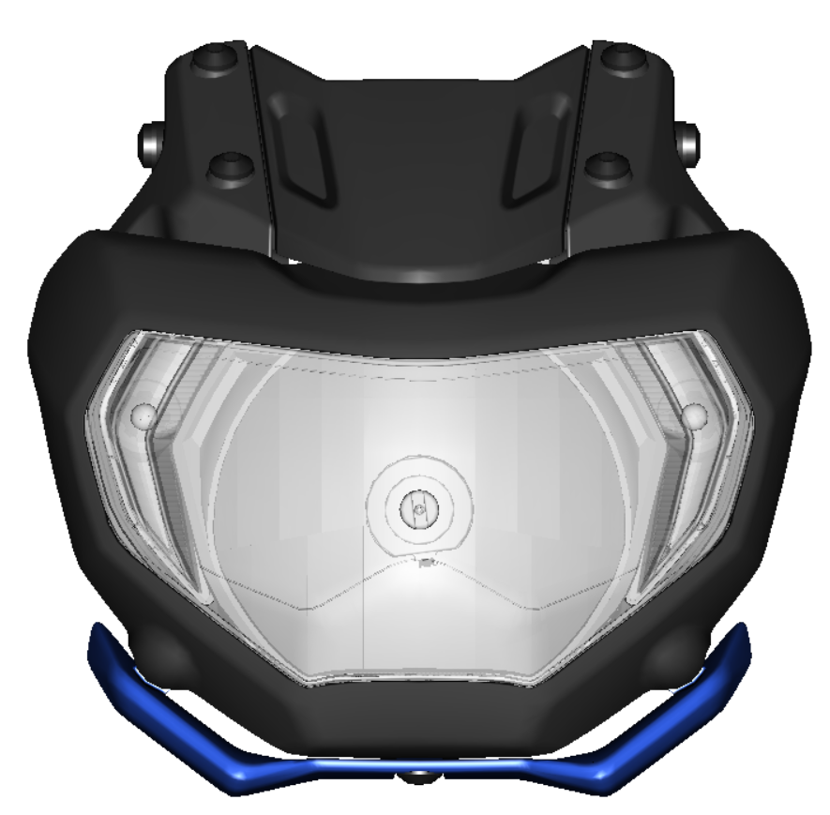
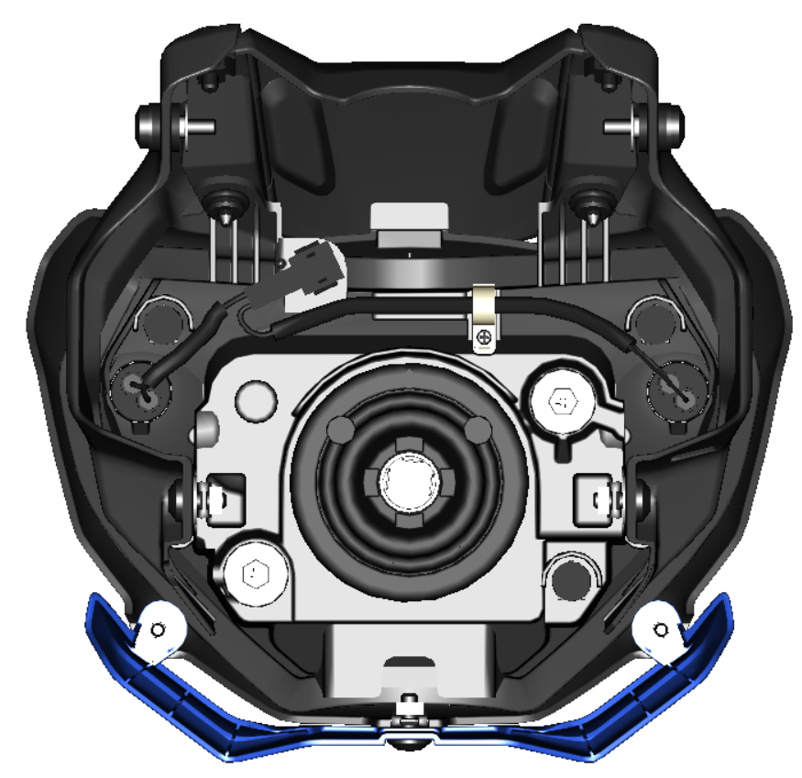
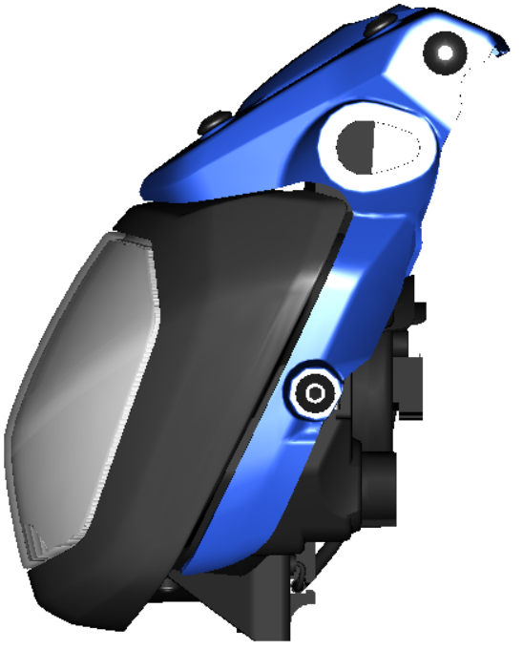
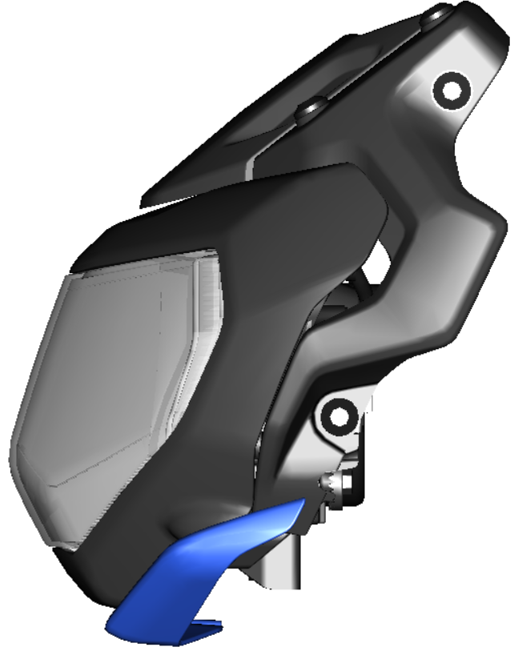
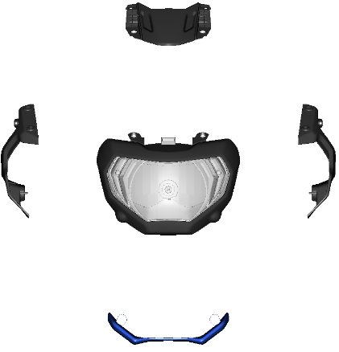
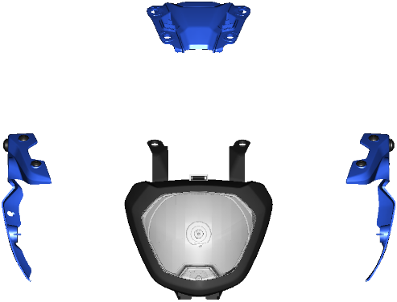
Headlight
New exterior design
Newly designed headlight is adopted
Newly designed covers and winglet are adopted
Auxiliary light location is changed
Attractive appearance
Headlight cover
Headlight lens
Auxiliary light
Front view
Rear view
Front view
Rear view
Auxiliary light
1WS
H72
Winglet
Side view
Side view

Slide 20
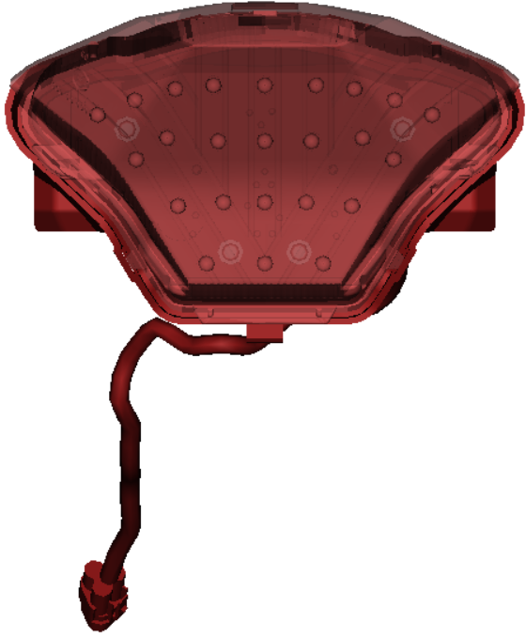
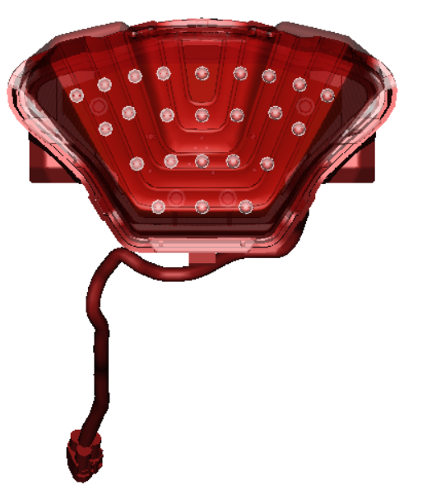
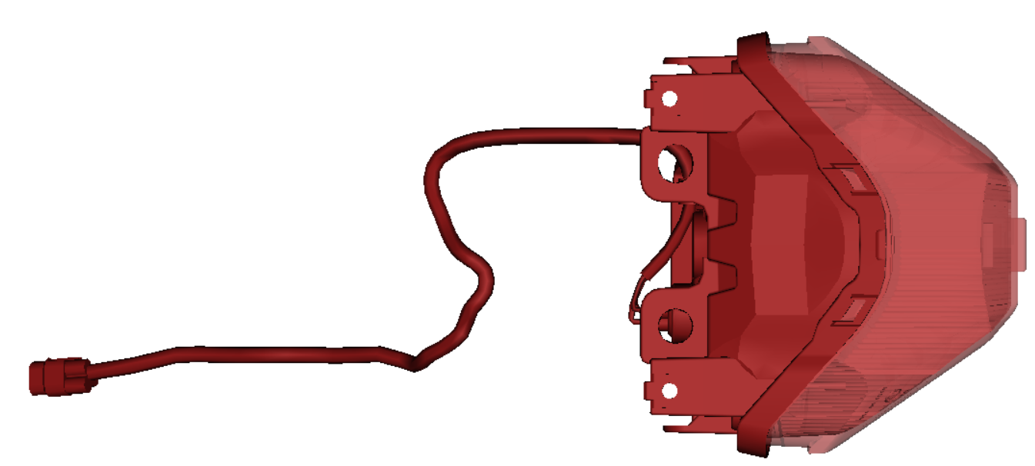
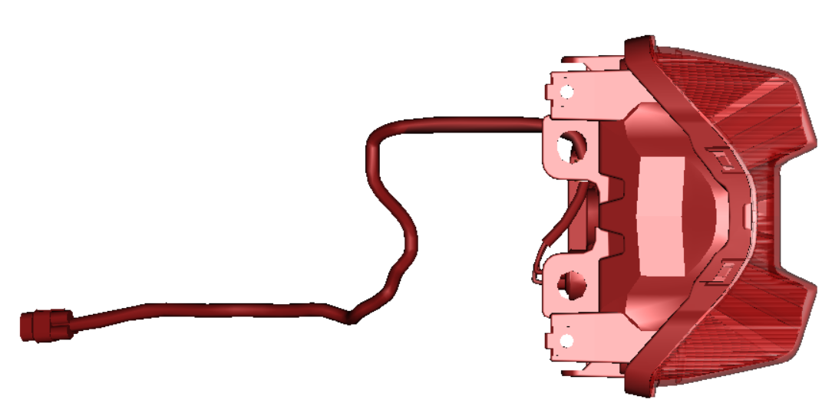
Taillight
New exterior design
Newly designed LED taillight is adopted
External lens shape is changed
Attractive appearance
Taillight turn on 6 leds of each side light
Rear view
Rear view
Stop light turn on all leds light
Top view
1WS
Top view
H72

