Slide 1
046
2018
6th Nov. 2017
B6C1 (EUR)
B6C2 (AUS)
B6C4 (RUS)
29th August 2017
YMCP18-007

Slide 2
 | Distributor | Standard Time | Date and Time | Applocable Model Code
Global Embargo | YMENV | GMT | 6th NOV' 17 21:00 | B6C1
Local release | YMA | (AEST/AETD) | NOV' 17 | B6C2
* Local release dates are set based on each local marketing strategy.
* Any information for each model code can’t be disclosed by above mentioned local release date.

Slide 3
4
5
6

Slide 4
“MT-09 al dente suspension sauce aux OHLINS”
The design can be prided as Deluxe.
Special coloring for SP model
Inverse display meter
Double stitch seat
EUR,AUS,RUS
B6C1,2,4…SMX (Black Metric X)
High quality suspension system for sports riding.
Fr: Specification change （Appearance change）
Rr: OHLINS suspension

Slide 5
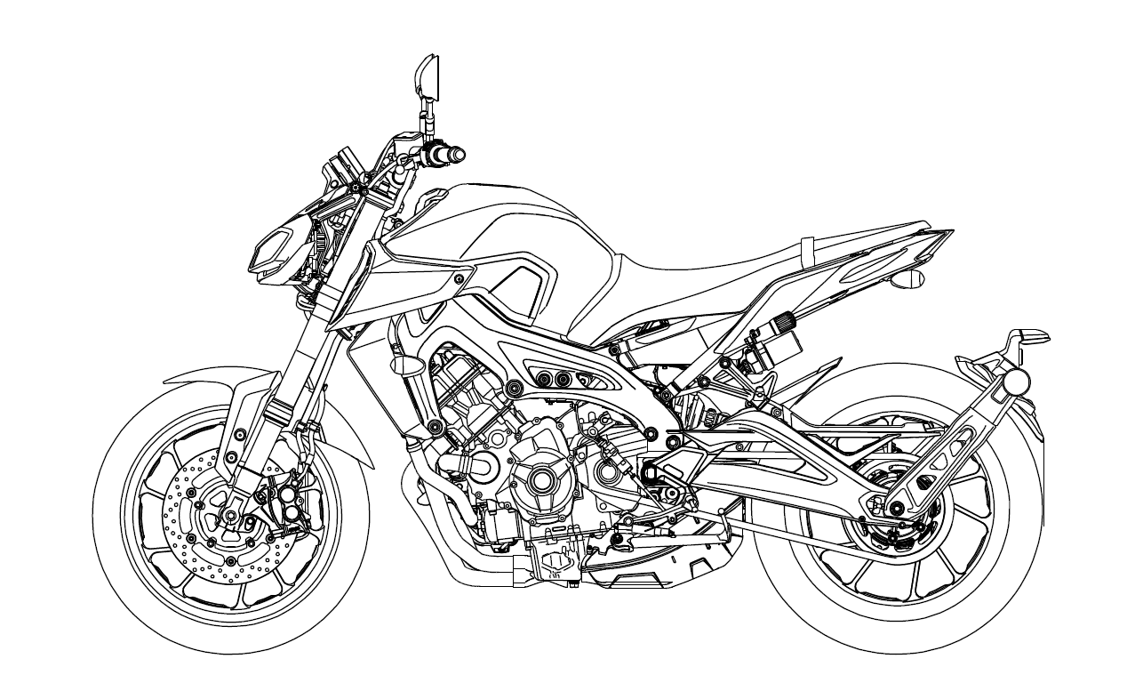
Running weight: 193kg
Weight ratio: Front 50.2%(97kg), Rear49.8 %(96kg)
* Same as BS2
Function
Design
Black color handlebar
Black color lever
Inverse display meter against BS2
Rebound / compression damper adjustable front fork
Painted in different color fuel tank
Double stitch seat
OHLINS Rear shock absorber
Rim graphic
リムグラフィック
（前後）

Slide 6
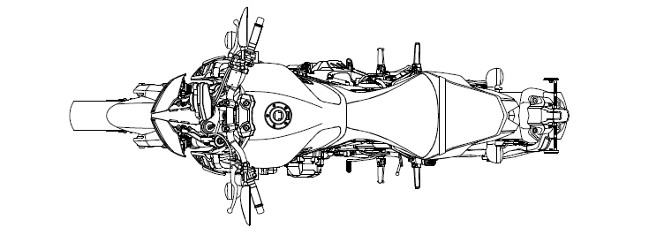
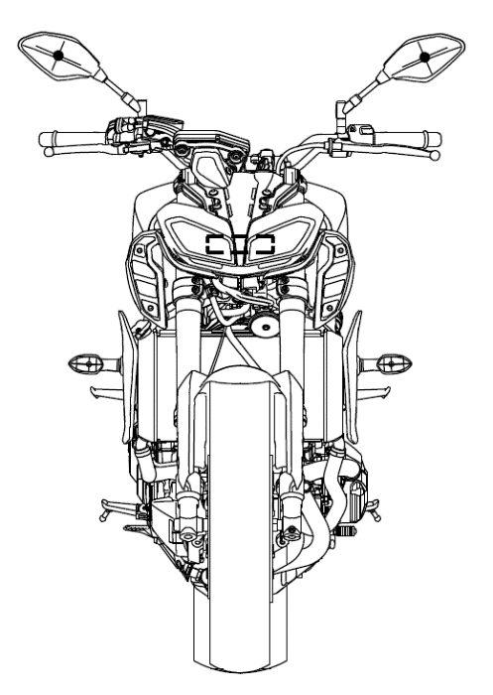
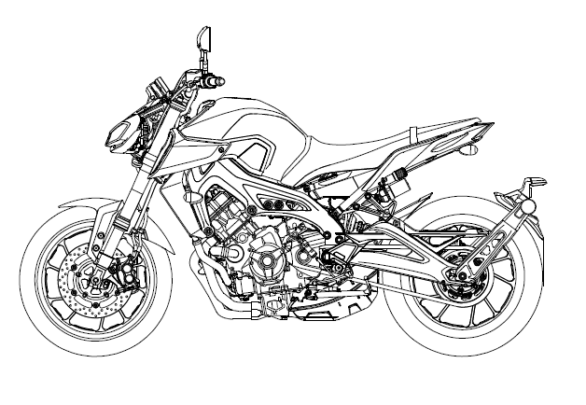
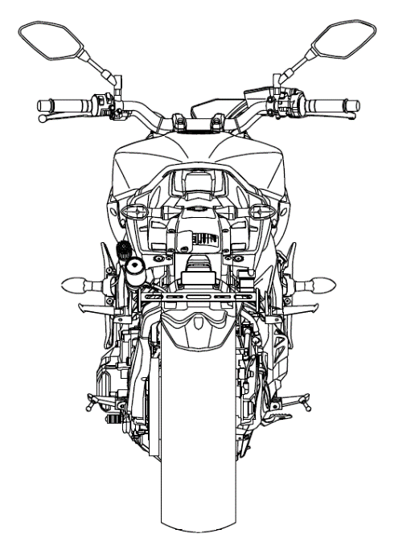
Dimension Map: 046
ITEM |  | 046 | BS2
A | Overall length | 2075 mm | ←
B | Overall width | 815 mm | ←
C | Overall height | 1120 mm | ←
D | Seat height | 820mm | ←
E | Wheel base | 1440 mm | ←
F | Minimum ground clearance | 135 mm | ←
G | Caster angle | 25 degrees | ←
H | Trail | 103 mm | ←
B
* Same as BS2
C
G
D
F
H
E
A

Slide 7
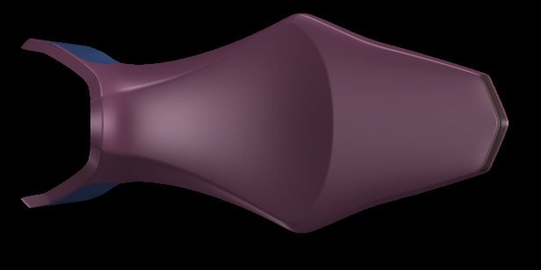
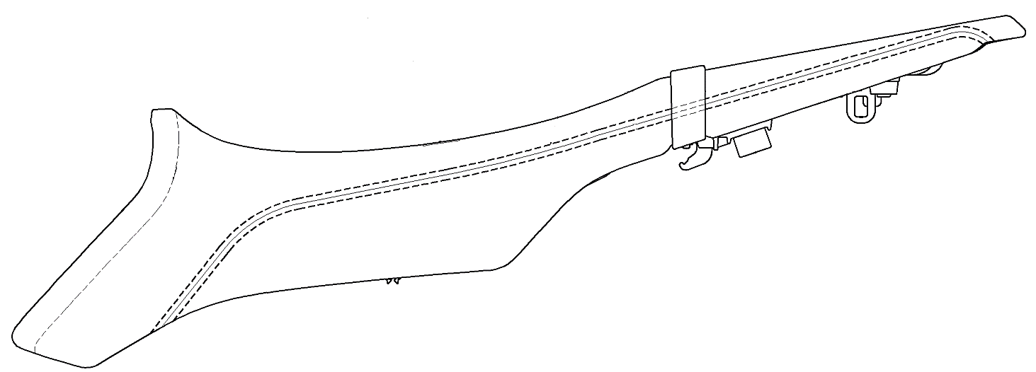
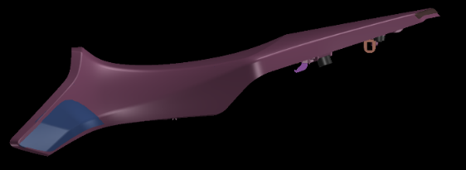
Double seat
New design flat shape double seat is adopted.
The double stitch is added for Deluxe design.
The design can be prided as Deluxe.
385.8 mm
282.1 mm
363.0 mm
Double stitch
BS2
046

Slide 8
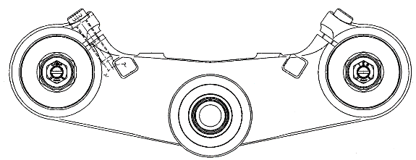
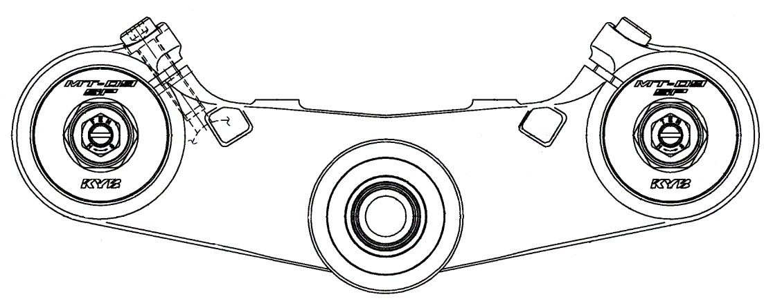
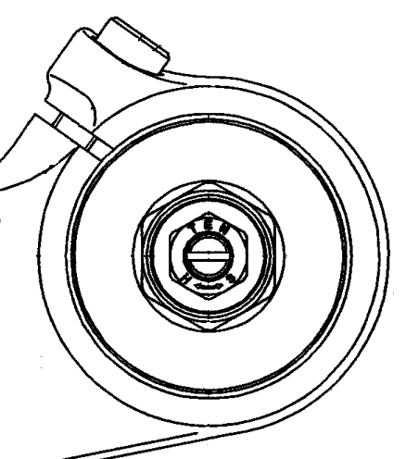
Front fork cap
New design front fork which is manufactured by KYB is adopted.
“MT-09SP” and “KYB” stamps are added for Deluxe design.
The design can be prided as Deluxe.
BS2
046

Slide 9
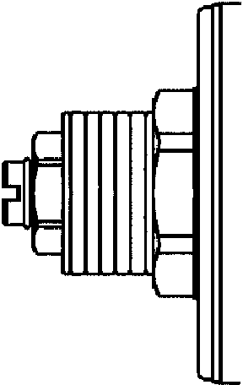
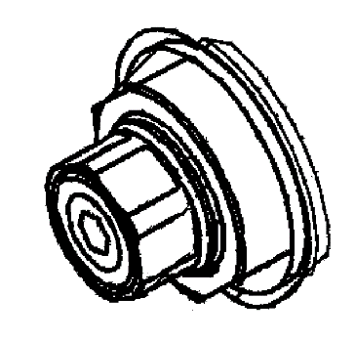
Front suspension
Adjustable rebound / compression damper
Both of suspension (left & right ) works for rebound and compression damping.
* In case of BS2, right fork works for rebound, left fork works for compression damping.
High quality suspension system for sports riding
Rebound damping adjuster
High speed compression damping adjuster
Compression damping adjuster
Rebound damping adjuster
Initial adjuster
Low speed compression damping adjuster

Slide 10
Front suspension
Both of suspension (left & right ) works for rebound and compression damping.
* In case of BS2, right fork works for rebound, left fork works for compression damping.
Rebound and compression side full adjustable
Item |  |  | 046 | BS2
Front fork stroke |  |  | 137mm | 137mm
Spring spec | Free length |  | 305.3mm | 300.3mm
 | Spring rate (K₁) |  | K1=6.86N/mm, K2=9.32N/mm | 7.35N/mm
Fork oil | Recommend oil |  | Yamaha suspension oil 01 | Yamaha suspension oil 01
 | Quantity (each front fork leg) |  | Left: 438cm³ Right: 438cm³ | Left: 458cm³ Right: 462cm³
 | Oil level (Max compression, without spring) |  | Left: 174mm Right: 174mm | Left: 148mm Right: 148mm
Setting | Spring preload setting (hard/std/soft) |  | 4mm/18mm/19mm | 4 mm/ 16mm /19mm
 | Damping adjusting position | Rebound (soft/std/hard) | 26/17/0 clicks | 11/11/0 Clicks (right front fork only)
 |  | Compression (soft/std/hard) | High speed: 3 turned out / 5.5 turned out / fully turned in * With the adjusting screw fully turned in direction. | 11/11/0 Clicks (left front fork only)
 |  |  | Low speed:18/11/0 Clicks

Slide 11
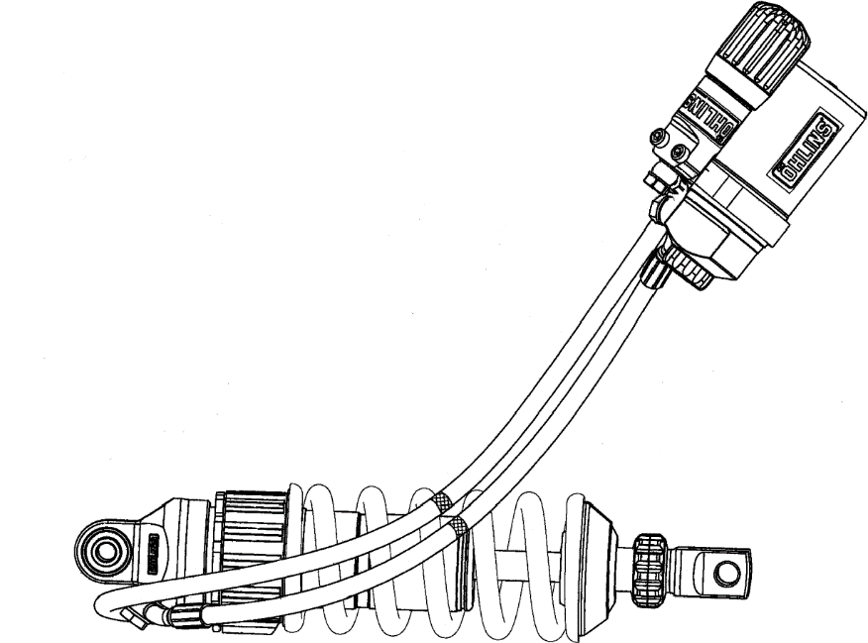
Rear shock absorber
OHLINS rear shock absorber.
High quality suspension system for sports riding
Item |  |  | 046 | B21
Rear suspension stroke |  |  | 65.5mm | 60mm
Spring spec | Free length |  | 170mm | 191.4mm
 | Spring rate (K_{R}) |  | 95N/mm | 99.9N/mm
Setting | Spring preload setting (hard/std/soft) |  | 16/14/0 | 7/4/1
 | Damping adjusting position | Rebound (hard/std/soft) | 0/12/30 clicks | Fully turned in/1 ½ turn out/3 turn out
 |  | Compression (hard/std/soft) | 0/14/16 clicks | N.A.
Spring initial adjuster
Hydric preload adjuster
Compression adjuster
Rebound adjuster

